Slide 1
Disbursement of Government Pensions by Banks

Slide 2
Government Pension Schemes
Civil Pensions:
www.cpao.nic.in
www.persmin.nic.in
Defence Pensions:
www.pcdapension.nic.in
RBI Circulars
Bank Circulars
The various Pension Schemes are different and must be read carefully to understand the variations.

Slide 3
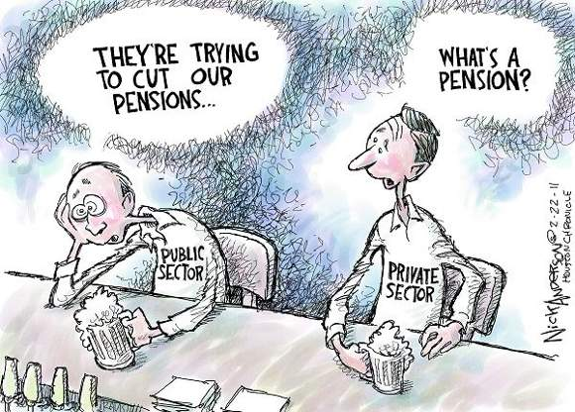
Pensioned Society
Pensions are wages kept in trust until Retirement

Slide 4
Importance of Pension Business
Very Important and Socially Useful work – People in Delhi Still remember T.J.A. Ganiga, a banker who excelled in serving 130,000 pensioners of his branch
Automatically brings in Customers to the Bank
Pensioners are worthy customers who are ambassadors of their Bank
Important source for business development

Slide 5
Profits from Pension Business
Fee income – NPA free
Total credits every month of Rs. in Pensioners’ accounts
Accuracy and Efficiency are important as the profits can be adversely affected by:
Delays in settlement
Overpayments
Extra staff costs

Slide 6
Dearness Relief
Before the CPPCs came into existence, the Timely payment of Dearness Relief to all the pensioners was always a contentious issue.
Now the banks have to just log on to the Pensioners’ Portal of Department of Pensions, download the latest Circular and implement it.
The Dearness Relief Orders apply to Central Civil, Armed Forces & Defence Civilians, All India Services, Railways, Burma Pensioners and Employees absorbed in PSUs who have become eligible for restoration of 1/3rd commuted portion of pension.

Slide 7
Credit of Pension to Joint Account
Former or Survivor
OR
Either or Survivor
(with Spouse in whose favour an authorization for Family pension exists)
Spouse can continue the same account in case of family pension and there is no need for opening a new account.

Slide 8
NOMINATIONS
Form A
Form B
The name of the nominee should be endorsed on the front page of the passbook.

Slide 9
AIS Officers
Accounting Procedure for AIS Officers retiring from GOI while on Central Deputation:
PPO no. includes a prefix for Service and State
SSA is in blue colour
Copy of SSA is sent to AG for information/record
Scroll to be sent to

Slide 10
Pension Slip
Issue of Pension Slip
On commencement
On change in quantum of pension
Now you can log into CPAO website for Pensioner Registration and get up to last 6 transactions
Recovery/ Refund of overpayments
Compensate the pensioner over delay
@ 8% w.e.f. 1st October, 2008.

Slide 11
Help the Hapless
Old
Sick
Incapacitated
Disabled

Slide 12
Life Certificate
Pensioners are required to furnish a life certificate every year in November
The Format of Life Certificate has been modified by CPAO in October 2015
The new Format provides for an Acknowledgement
Digital Life Certificate called Jeewan Pramaan has also been launched in November 2014
This certificate has Aadhar based biometric authentication.

Slide 13
Pension Payment Orders
Correct feeding of numbers is important
PPO should be updated on change in basic rates of pension/ DR

Slide 14
Payments to Defence Pensioners
Delay in submission of Pension Payment Scrolls
Fake and Fraudulent Payments
First Payment of Pension
Single Window System

Slide 15
Payments to Railway Pensioners
Fake and Fraudulent Payments
Overpayment of Pension
Issue of Due and Drawn Statement
Single Window System

Slide 16
Areas of Overpayments
Wrong Revision
Continued payment of Enhanced Family Pension
Wrong payment of personal pension betond 1996
Continued payment of Family Pension beyond 25 years of age
Wrong stepping up of Ex Gratia Payment to minimum Family Pension
Wrong payment of Fixed Medical Allowance
Payment of Dearness relief at higher rates
Non collection of required certificates/ Life certificates.

Slide 17
Customer Service
Courtsey/ gesture
Information
Due and drawn statement
Pension Slip
Updation of PPO
Promptness
Branch to take responsibility and settle the grievance
Coordination

Slide 18
PENSIONERS’ MEET,
NEW DELHI

Slide 19
Prabhakar Rao Committee
Bank Staff should be sensitized to pension work
Avoid Delays, avoid overpayments
Structured interaction with pensioners on a regular basis
Regular training for bank personnel
Recommended setting up of a centralised pension cell
Branch should continue to be a point of referral for the Pensioner
During Internal Inspection of branches, service to pensioners should be evaluated.

Slide 20
Check List Relating to Pension Payments
Delay in payment of pension, revision of pension, revision of Dearness Relief
Delay in restoring full pension after 15 years
Cases of Overpayments
Status of Nominations for Pension accounts
Conversion of Pension accounts into Joint accounts
Whether Pensioners complaints are promptly attended
Whether Life Certificates etc are being obtained
Whether TDS is being deducted from Pensions

